Slide 1
Graphs

Slide 2
What is a graph?

Slide 3
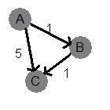
In simple words,
A graph is a set of vertices and edges which connect them.
A node (or vertex) is a discrete position in the graph.
An edge (or connection) is a link between two vertices
A simple example of a graph is a single linked list.

Slide 4
Types of graphs
Directed Graph - The edge connecting the nodes has a particular direction. This allows traversal in only one direction.
Undirected Graph - This is a two way connection between both the nodes. This allows traversal in both the directions.
Weighted Graph - Each edge has a value attached to it.

Slide 5
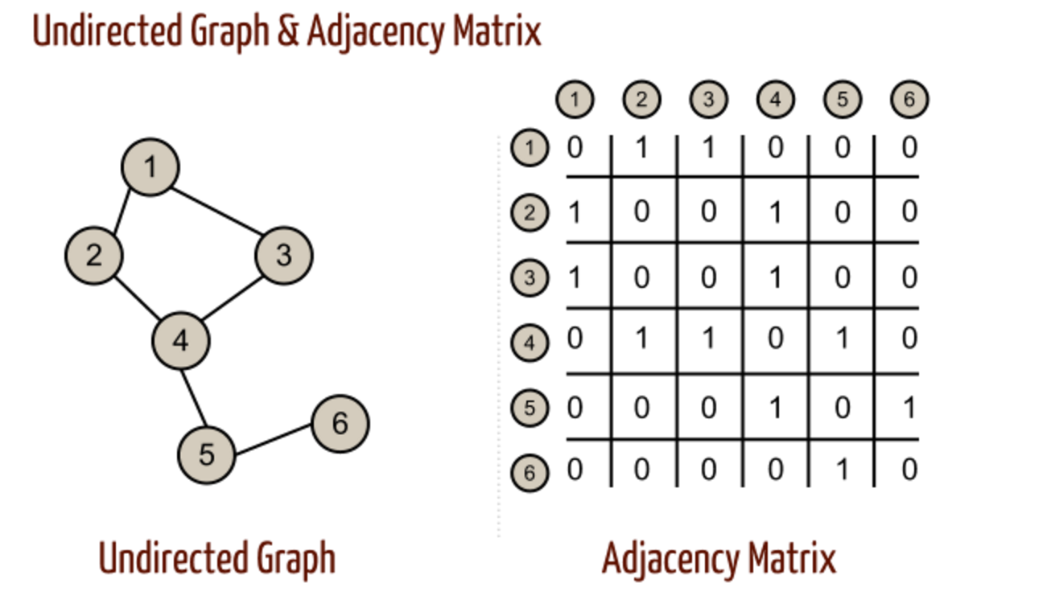
How to represent a graph?
Adjacency Matrix - Each cell aij of an adjacency matrix contains 0, if there is an edge between i-th and j-th vertices, and 1 otherwise.

Slide 6
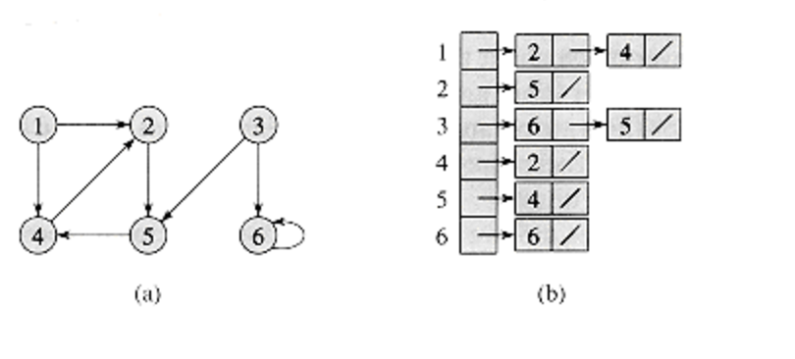
How to represent a graph?
Adjacency List - This kind of the graph representation is one of the alternatives to adjacency matrix. It requires less amount of memory and, in particular situations even can outperform adjacency matrix. For every vertex adjacency list stores a list of vertices, which are adjacent to current one.

Slide 7
How is a graph different from a tree?
Let us take an example
If you wanted to start a family tree (a hierarchal organization of children to parents, starting from one child) you would not be able to store more than one parent per child.
It might be possible to form a loop because every mother has mother and father, and every father has a mother and father, and so on.
A tree clearly cannot have a loop.
A tree only allows a node to have children, and there cannot be any loops in the tree.
A more formal definition of a tree is that it is a connected acyclic graph. This simply means that there are no cycles in the graph and every node is connected to at least one other node in the graph.

Slide 8
How to recognize if a given problem is a graph problem?
Hints :
If concepts of grids and networks are used.[Problems may not be this direct always].
If you are required to find a path of any sort, it is usually a graph problem as well.
Graphs can represent many different types of systems, from a two-dimensional grid to a map of the internet that shows how long it takes data to move from computer A to computer B.
Common keywords to look out for -
vertices
nodes
edges
connections
connectivity
paths
cycles
direction

Slide 9
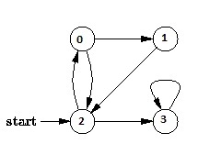
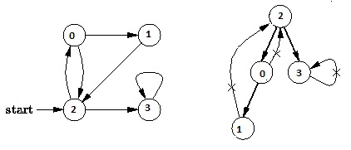
How to traverse a graph?
Two common techniques :
Breadth First Search
In breadth-first search (BFS), we start at some arbitrary node of a graph, sometimes referred to as a 'search key’, and explore the neighbor nodes first, before moving to the next level neighbors. Breadth First Traversal of the following graph is 2, 0, 3, 1.
Depth First Search
In depth-first search (DFS), one starts at the root (selecting some arbitrary node as the root in the case of a graph) and explores as far as possible along each branch before backtracking. Depth First Traversal of the following graph is 2, 0, 1, 3.

Slide 10
Breadth First Search Algorithm
void BFS(int s)
{
// Mark all the vertices as not visited(By default
// set as false)
boolean visited[] = new boolean[V];
// Create a queue for BFS
LinkedList<Integer> queue = new LinkedList<Integer>();
// Mark the current node as visited and enqueue it
visited[s]=true;
queue.add(s);
while (queue.size() != 0)
{
// Dequeue a vertex from queue and print it
s = queue.poll();
System.out.print(s+" ");
// Get all adjacent vertices of the dequeued vertex s
// If a adjacent has not been visited, then mark it
// visited and enqueue it
Iterator<Integer> i = adj[s].listIterator();
while (i.hasNext())
{
int n = i.next();
if (!visited[n])
{
visited[n] = true;
queue.add(n);
}
}
}
}

Slide 11
Applications of Breadth First Search Traversal
Computer Graphics:
We use the Breadth First Search traversal technique in Computer Graphics to compute optimal distance between any two points
We can extend this technique to apply it in other fields such as Computer Networks and Cartography as well.

Slide 12
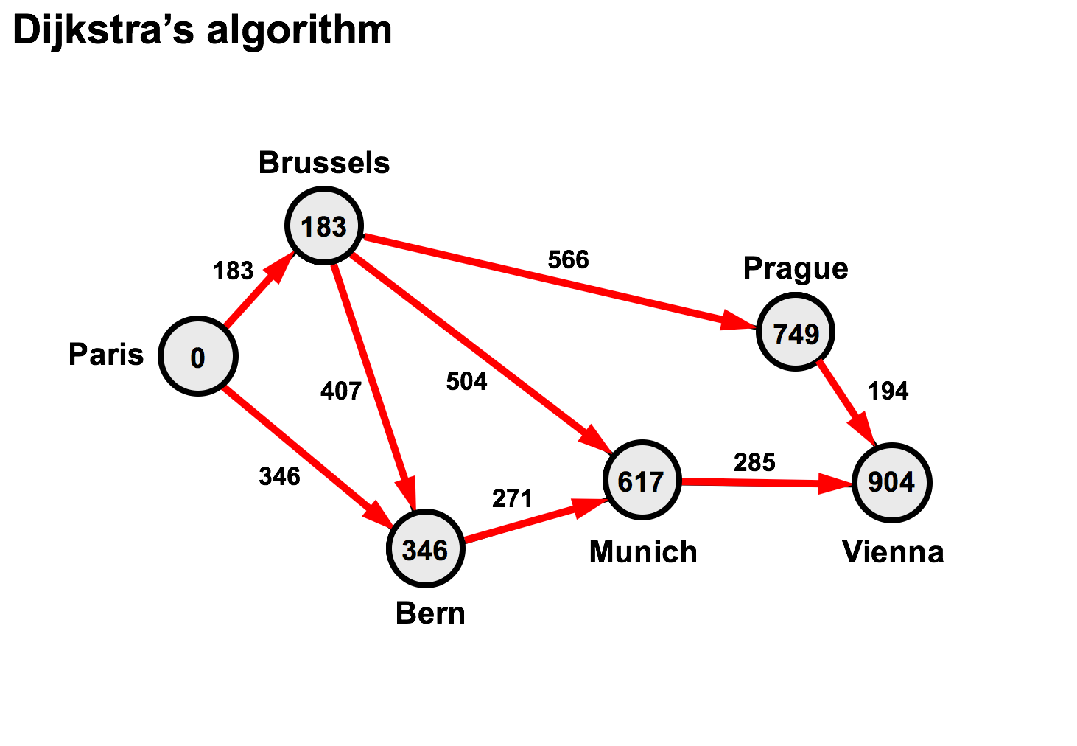

Slide 13
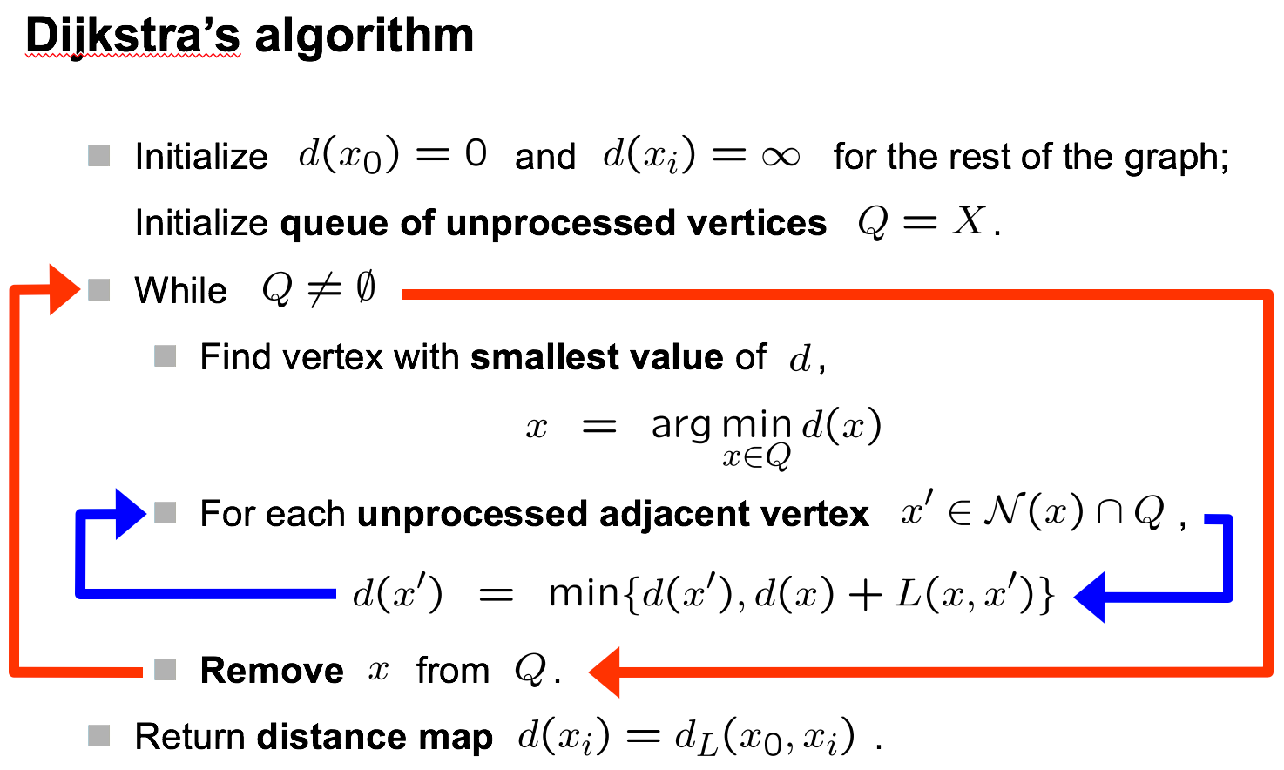

Slide 14
Depth First Search Algorithm
// A function used by DFS
void DFSUtil(int v,boolean visited[])
{
// Mark the current node as visited and print it
visited[v] = true;
System.out.print(v+" ");
// Recur for all the vertices adjacent to this vertex
Iterator<Integer> i = adj[v].listIterator();
while (i.hasNext())
{
int n = i.next();
if (!visited[n])
DFSUtil(n, visited);
}
}
// The function to do DFS traversal. It uses recursive DFSUtil()
void DFS(int v)
{
// Mark all the vertices as not visited(set as
// false by default in java)
boolean visited[] = new boolean[V];
// Call the recursive helper function to print DFS traversal
DFSUtil(v, visited);
}

